Slide 1


CSCI 5707 PRINCIPLES OF DATABASE SYSTEMS (FALL 2023) GROUP PROJECT TEAM NAME: SCHEMA SCHOLARS

Slide 2
TEAM MEMBERS
Sireesha Pothumudi
Student ID: 5880639
Email: pothu012@umn.edu
Sri Krishna Vamsi Koneru
Student ID: 5881358
Email: koner033@umn.edu
Suchithra Moolinti
Student ID: 5909334
Email: m0006012@umn.edu
Nithya Murikinati
Student ID: 5903224
Email: murik002@umn.edu

Slide 3

E-commerce Sales and Customer Behavior Analysis in usa

Slide 4
Table of contents
Project overview
Project Goals
Data Set
Tech Stack
Architecture
Data Normalization
Data base design
Data Cleaning
EDA
Data Visualization
Results Summary
References
Future work
Q & A

Slide 5
PROJECT OVERVIEW
About E-Commerce:
E-Commerce involves sale of products through online channels rather than traditional Mom & Pop stores or Brick & Mortar stores.
The share of E-Commerce sales compared to traditional commerce is increasing YoY and we have multiple players like Amazon, Walmart, Target aiming for a slice of this market.
Motivation:
Unlike traditional commerce where business builds trust over time to attract consumers, E-Commerce business excels by offering customers a sense of value or convenience.
This requires deeper understanding of customer behavioural patterns. Utilising OLAP we analyse customer purchase patterns such as sales with discounts plays a key role in gaining market share and expanding customer base.

Slide 6


GOALs
Analyze 2022 sales for patterns Understand sales peak, slump, monthly trends for the complete year
Analyze KPI impacting sales – Discounts
Understand how discounts impact sales value
Analyze KPI for customer categories
Understand customers segmentation based on purchasing behavior
Analyze KPI impacting sales – Location
Understand how order pattern varies per location
Analyze KPI impacting sales – Category
Understand the top selling categories/products

Slide 7

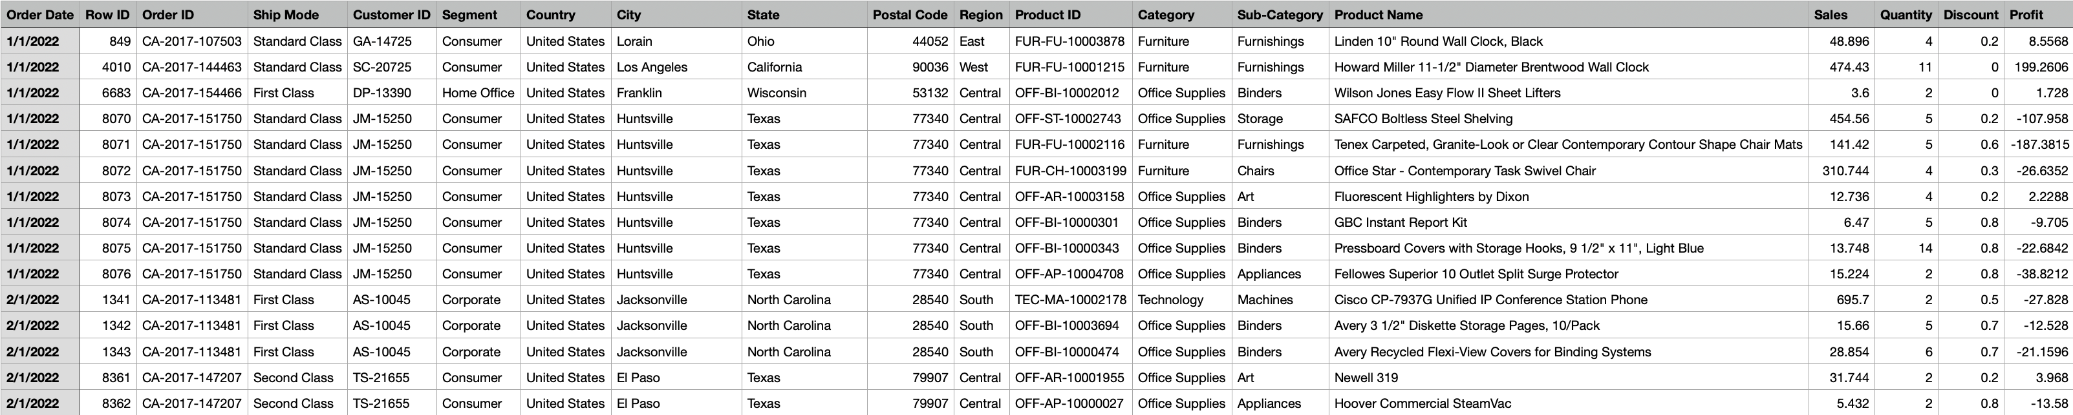
DATA SET
We have utilized an E-Commerce sales dataset for the year 2022 available on Kaggle for the purpose of this project.
This initial dataset was not usable readily. It has missing Order Id’s etc, special characters, inconsistent date formatting. In order to overcome these we had to perform data pre-processing.

Slide 8



TECH STACK
Standard SQL
Snowflake Datawarehouse
Power BI Visualization
Query language to fetch data from Snowflake Datawarehouse
Common language to query relational DB’s
Snowflake operates as a cloud-based service, eliminating the need for software installation or setup on local machines.
Allows collaboration for multiple users.
Provides ability to store and query large relational datasets
Column oriented data store – Efficient with storage & analytical queries
Used to visualize the data from Snowflake
Provides ability to drill down the dataset at different granularity or dimension as required by Business users

Slide 9
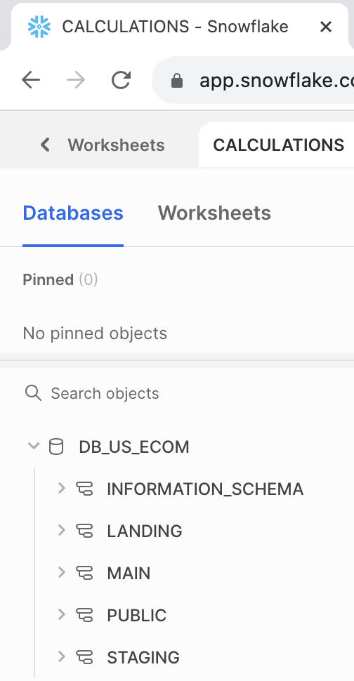
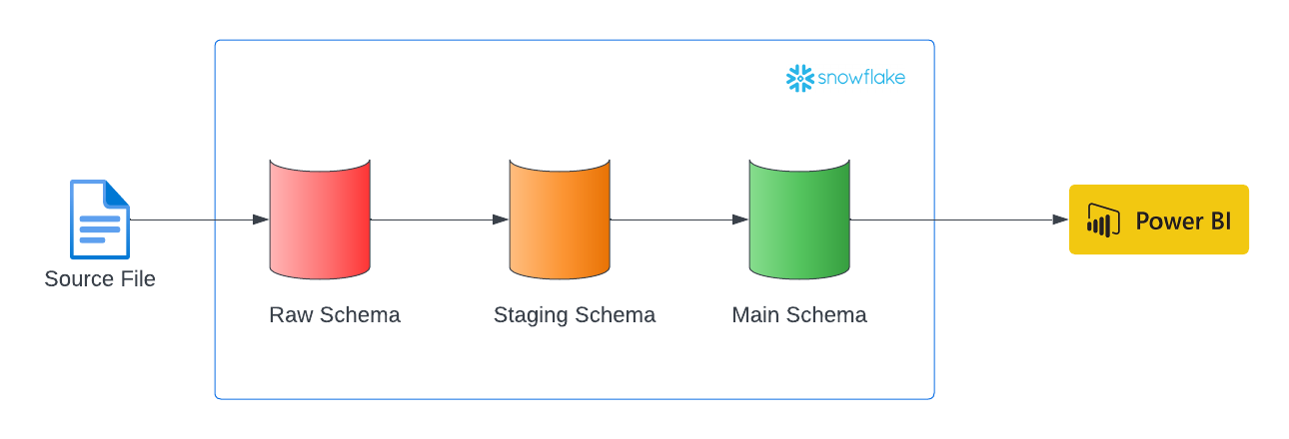
ARCHITECTURE
1. Source File: Ecommerce orders data loaded into Snowflake's 'raw' schema, preserving the original data format.
2. Stage Schema: Validates, cleanses, and flags erroneous data, residing in the 'stage' schema with error_flag = ‘Y’ and error_message.
3. Main Schema: Stores validated, error-free records from the 'stage' schema for reliable reporting purposes.
4. Power BI Integration: Connects directly to the 'main' schema for generating insightful reports and visualizations.
5. Data Flow: Ensures a controlled flow from raw data ingestion to refined, trustworthy data utilized in Power BI for informed decision-making.

Slide 10
APPROACH
DATA COLLECTION
EXPLORATORY DATA ANALYSIS(EDA)
VISUALIZATION
DATA NORMALIZATION
DATA CLEANING
Power BI Dashboard for all EDA metrics
3 tables
Customer dimension
Products dimension
Orders fact
Location vs Sales
Discounts vs Sales
Customers insights
Product sales insights
Location vs Customers
Understand data- set and create appropriate file format to load data into snowflake.
Special character handling
Handling NULL values
Add audit attributes like Update timestamp, Load timestamp, Input File name

Slide 11

DATA NORMALIZATION
To minimize redundancy and to ensure data integrity. Here's how we normalised our data:
Orders Fact Table:
The Orders table likely contains transactional data like order_id, row_id, customer_id, product_id, time_id, and other order-related details.
We Normalized this table by maintaining only the references (foreign keys) to the dimension tables instead of storing detailed information. For instance, instead of repeating customer or product details in every order, store references (customer_id, product_id) linking to the respective dimension tables.
Dimension Tables:
Customers and Products tables store detailed information about these entities.
We kept these tables in a normalized form, each containing specific attributes related to the entity they represent (e.g., customer details in the Customers table, product details in the Products table, etc.).
By normalizing the data, we maintain consistency, reduce redundancy, and create a structured, interconnected database model. It enhances data integrity and facilitates efficient querying and analysis across multiple dimensions while minimizing storage space.

Slide 12
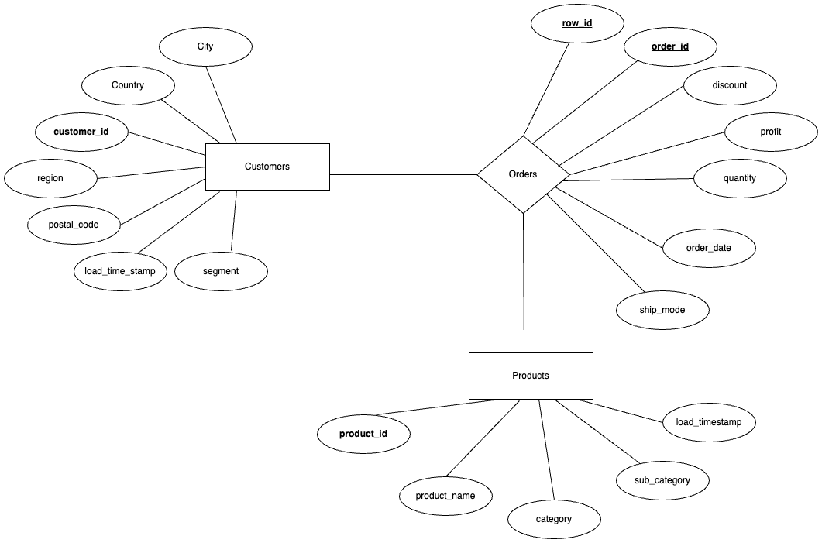
SCHEMA DESIGN / ER DIAGRAM
1. Fact Table - Orders: Central table capturing transactional data like order_id, product_id, customer_id, and order date, amount, discount etc.
2. Dimension Table - Customers: Holds details about customers, such as customer_id, name, address, contact details, etc.
3. Dimension Table - Products: Stores information about products, including product_id, name, description, etc.
4. Relationships: Establishes relationships between the Fact Table (Orders) and Dimension Tables (Customers, Products) through primary and foreign keys, enabling comprehensive analysis and reporting across various dimensions.

Slide 13
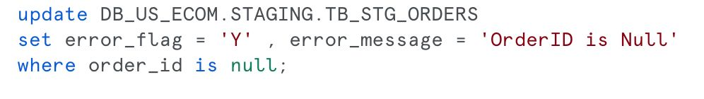
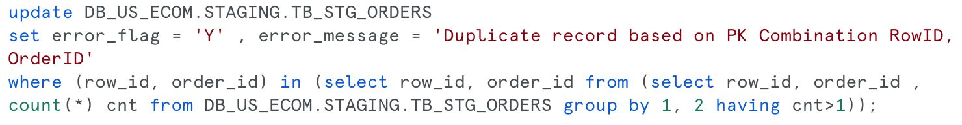
DATA CLEANING
Handling Missing Values:
Identify missing data points and decide how to handle them. Options include imputation (replacing missing values with calculated ones), deletion of rows.
Handling Duplicates:
Identify and eliminate duplicate records or entries in your dataset, ensuring data integrity and accuracy.

Slide 14
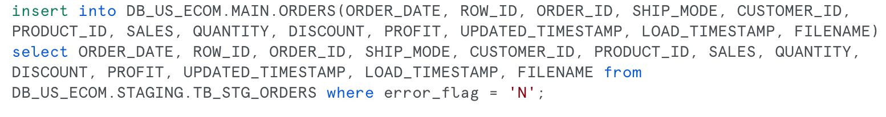
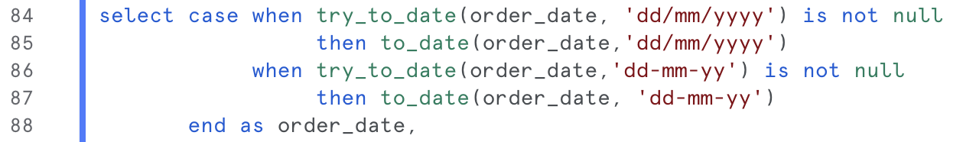
DATA CLEANING
Utilize Error Flagging and load data into main table:
As in your staging schema, flagging records that fail specific validations or checks helps in segregating erroneous data for further review.
Standardizing Data:
Standardize formats for consistency. For instance, standardizing date formats, units of measurement, or categorical data to ensure uniformity across the dataset.

Slide 15
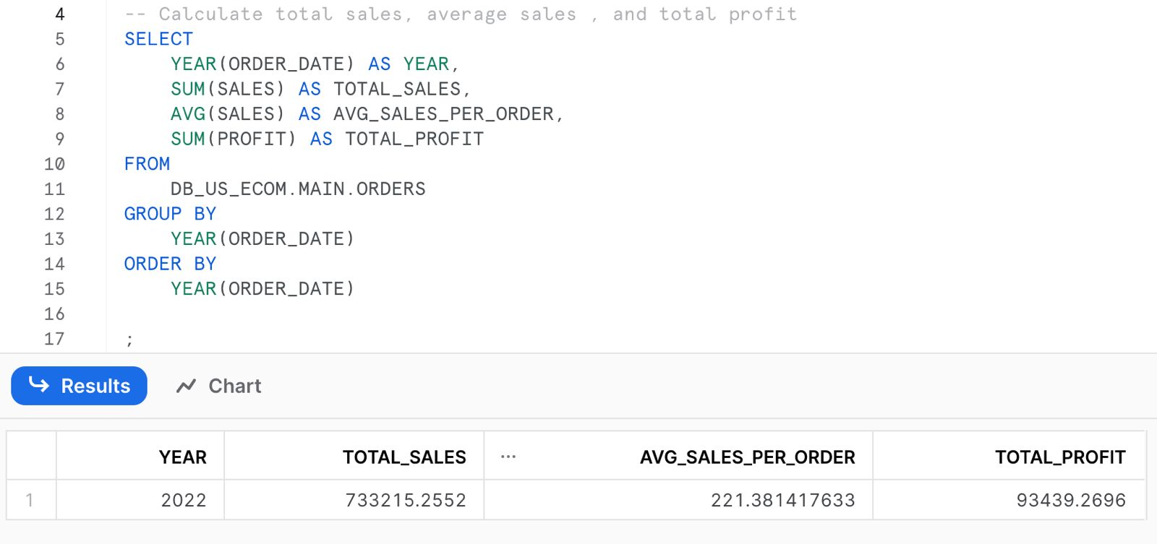
1. EXPLORATORY DATA ANALYSIS
Total sales, Average sales, and Total profit per Year

Slide 16
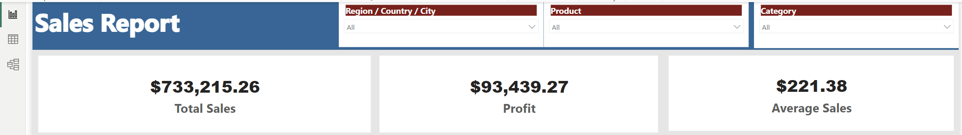
1. Data visualization
Total sales, Average sales, and Total profit per Year

Slide 17
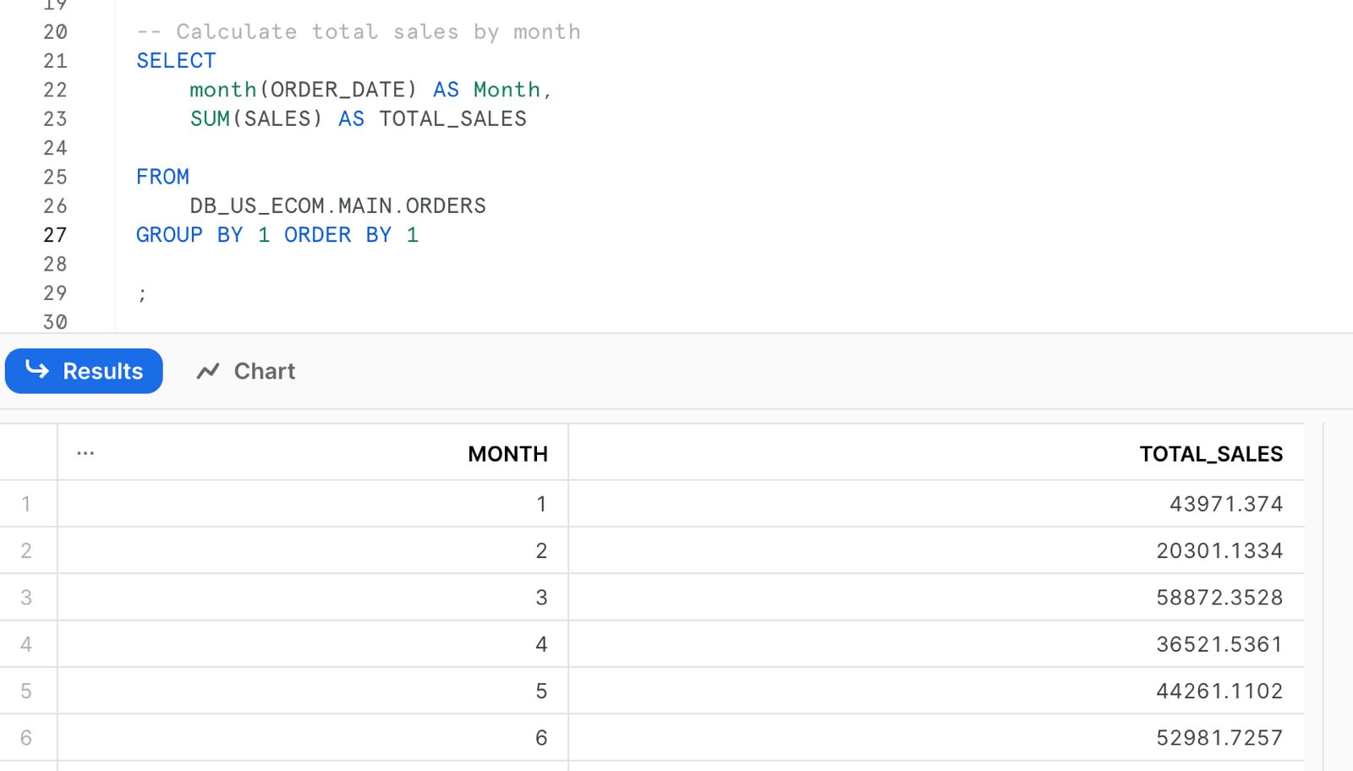
2. EXPLORATORY DATA ANALYSIS
Understand sales peak, slump, monthly trends for the complete year

Slide 18
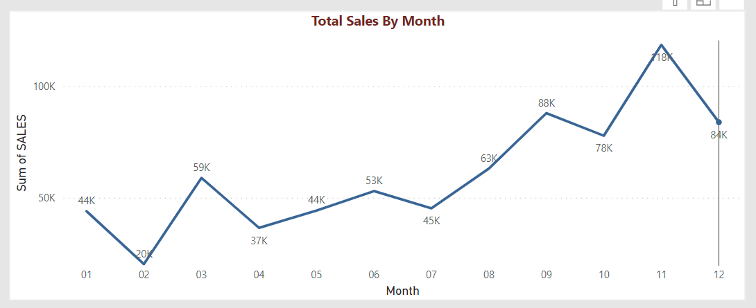
2. DATA VISUALIZATION
Understand sales peak, slump, monthly trends for the complete year

Slide 19
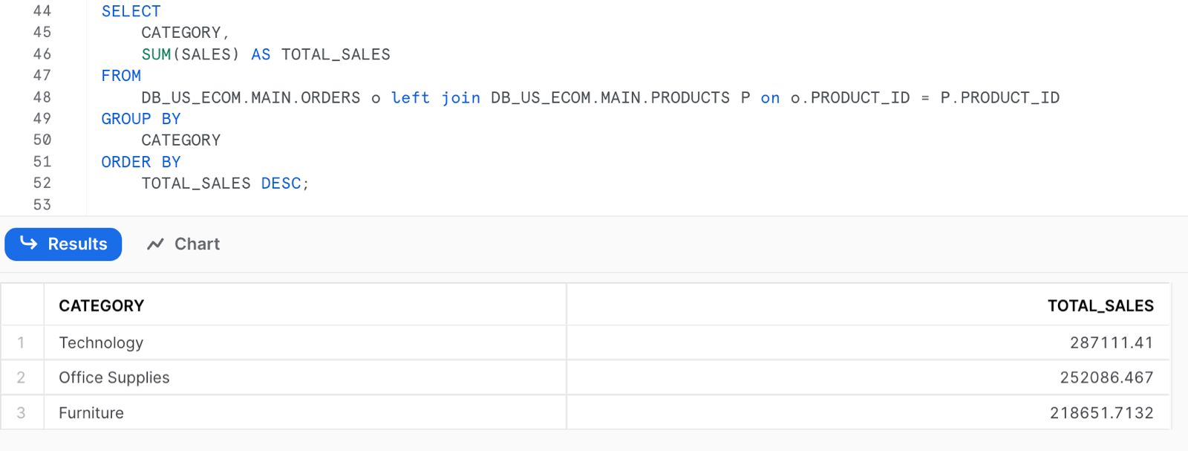
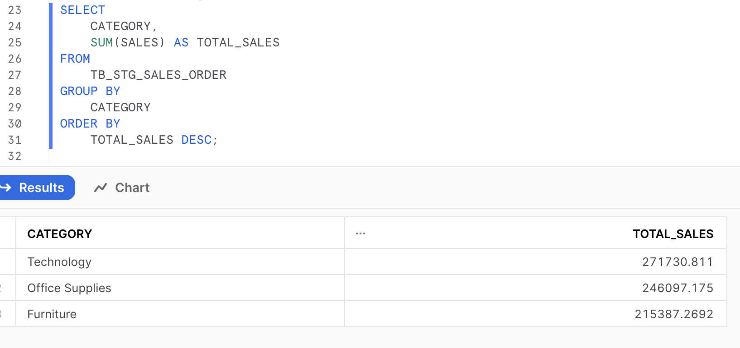
3. EXPLORATORY DATA ANALYSIS
Identifying popular product categories

Slide 20
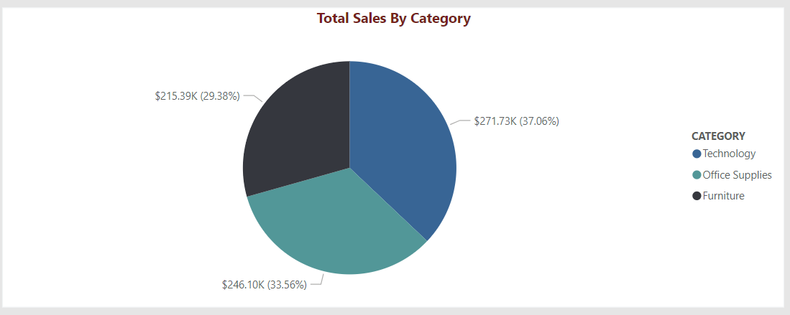
3. DATA VISUALIZATION
Identifying popular product categories

Slide 21
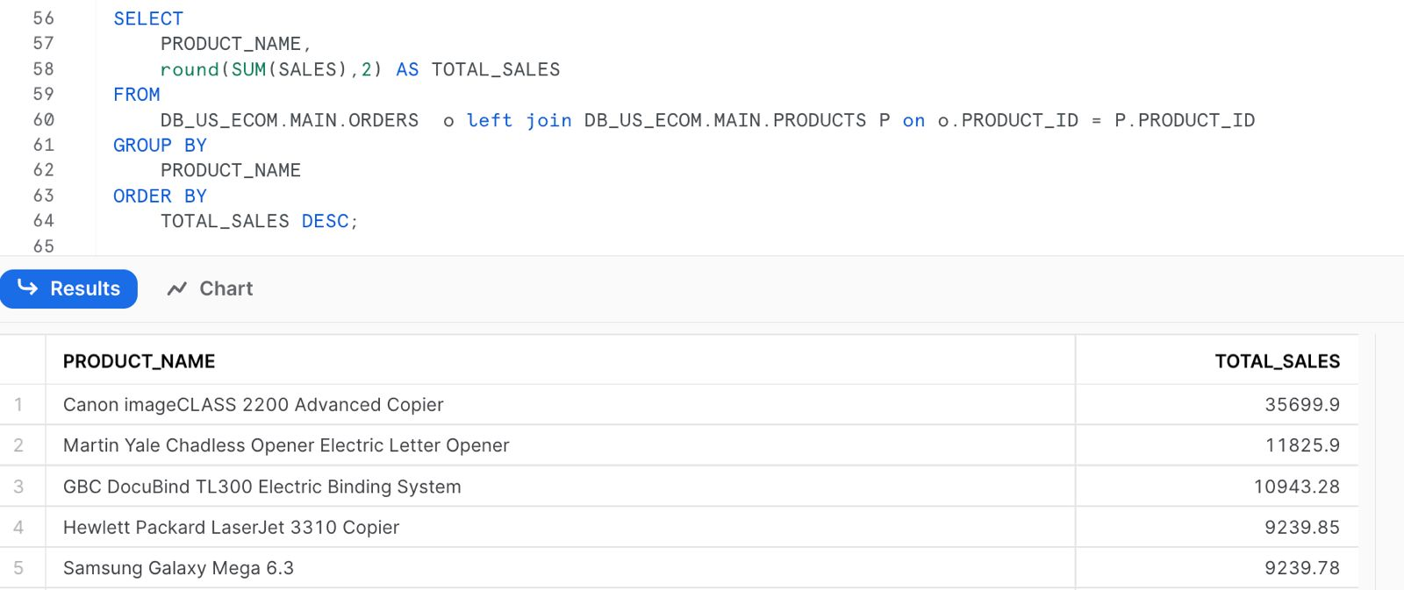
4. EXPLORATORY DATA ANALYSIS
Identifying TOP 5 products based on sales

Slide 22
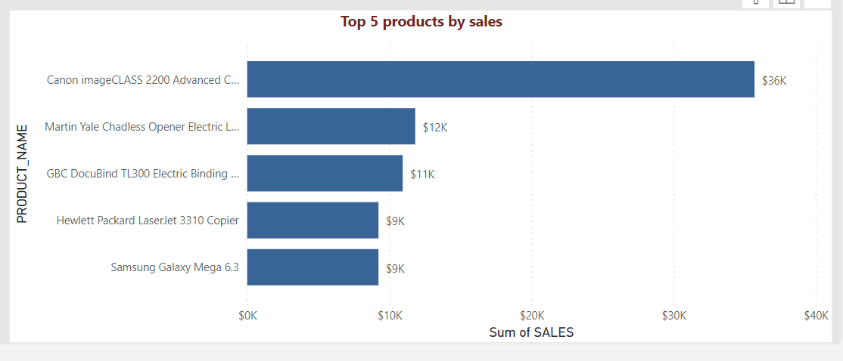
4. dATA VISUALIZATION
Identifying TOP 5 products based on sales

Slide 23
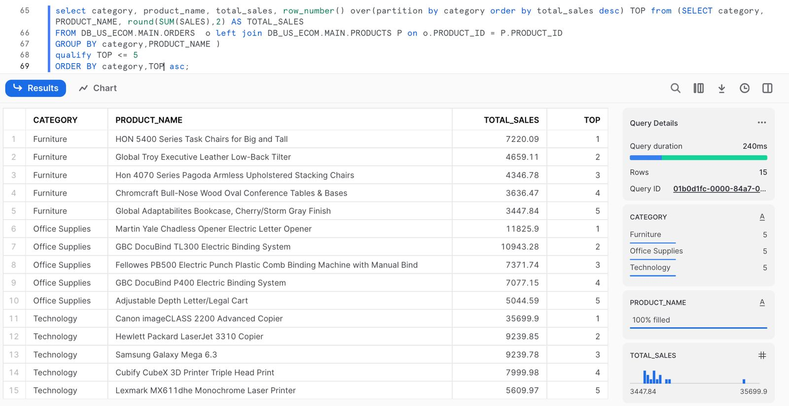
Identifying TOP 5 category wise products based on sales

Slide 24
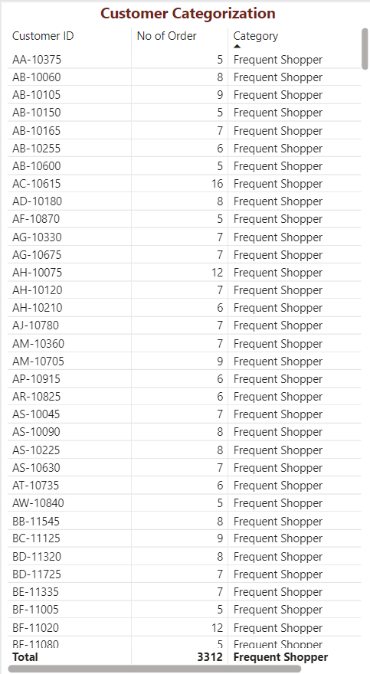
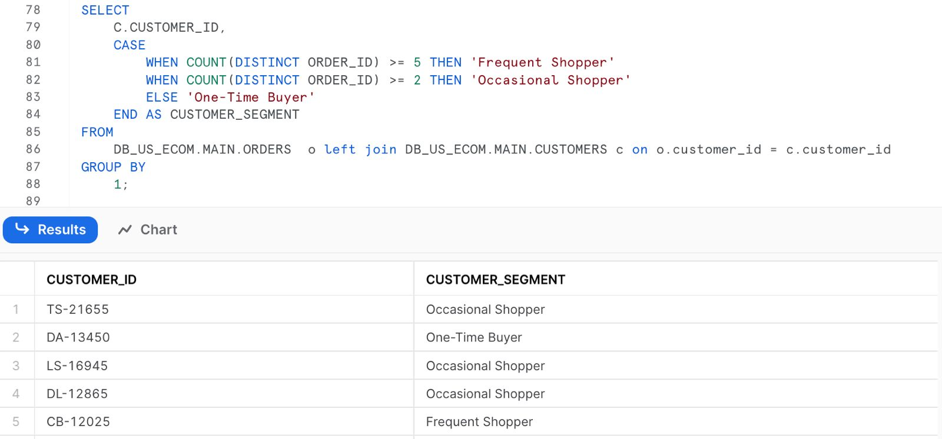
5. EXPLORATORY DATA ANALYSIS and visualization
Identifying Frequent/Occasional/OneTime Buyers

Slide 25
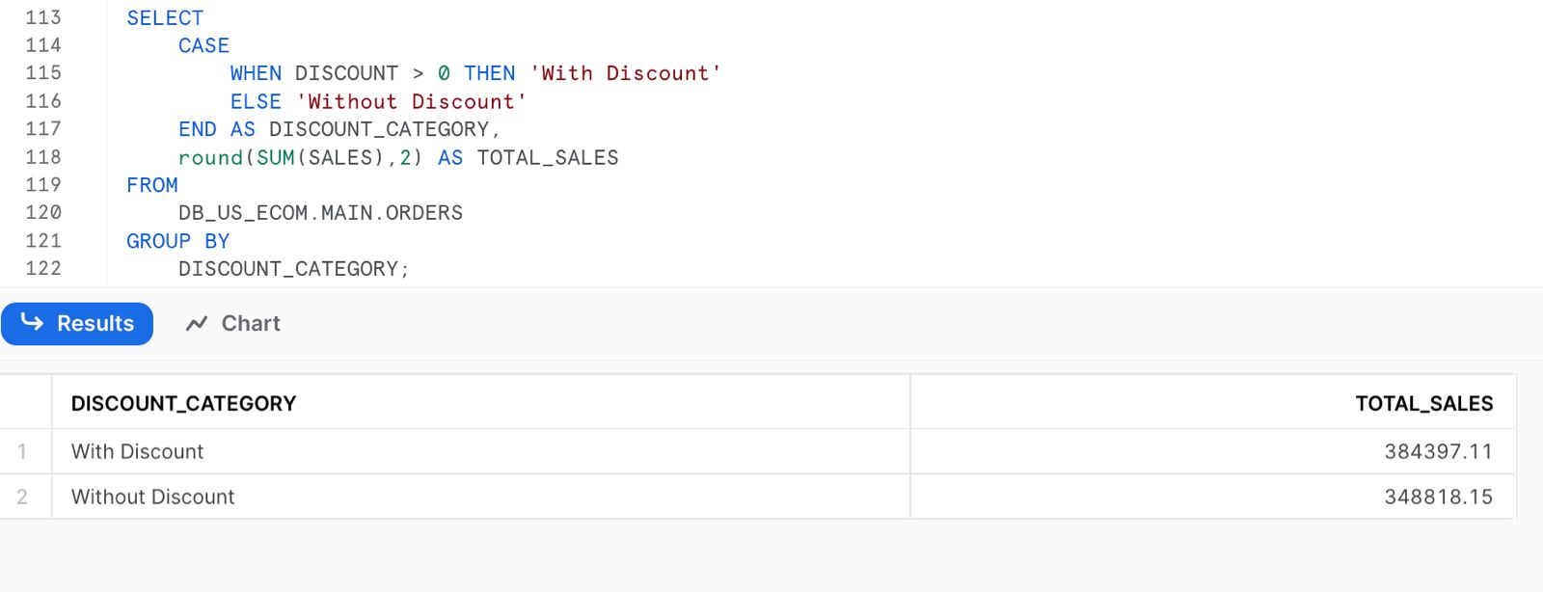
6. EXPLORATORY DATA ANALYSIS
Analyze Impact of Discounts based on Total Sales

Slide 26
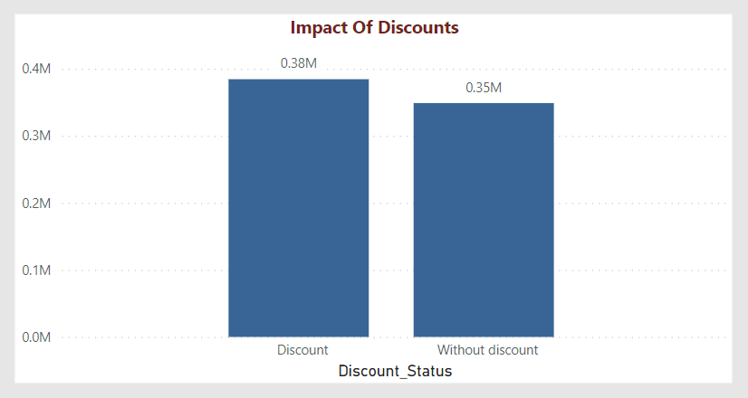
6. Data visualization
Analyze Impact of Discounts based on Total Sales

Slide 27
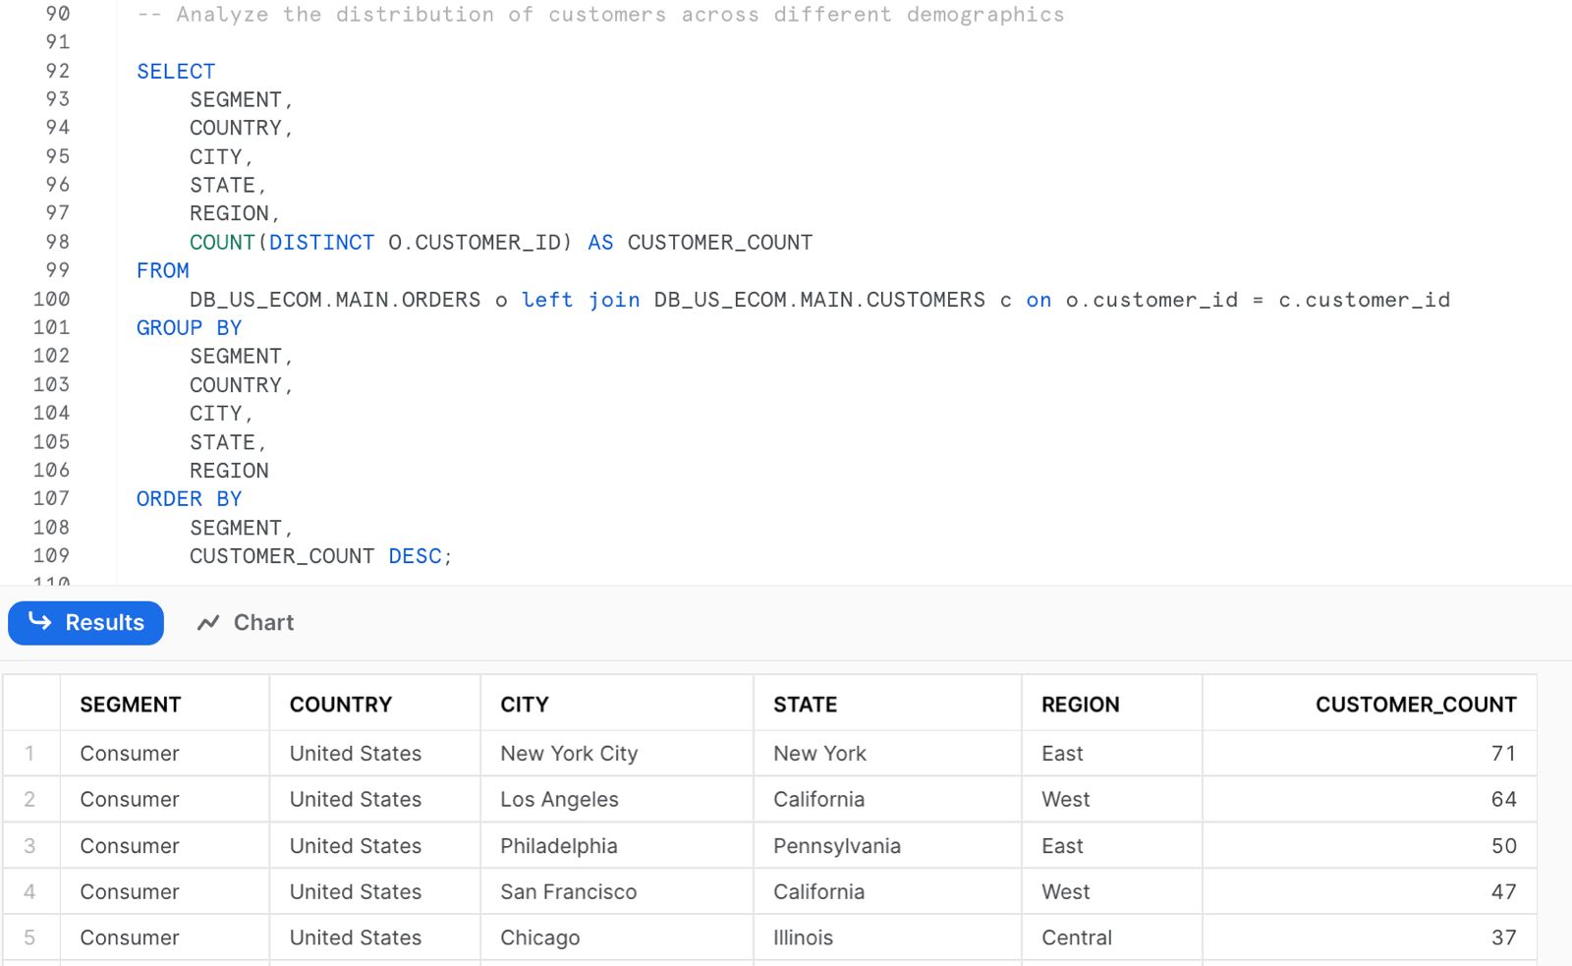
7. EXPLORATORY DATA ANALYSIS
The distribution of customers across different demographics

Slide 28
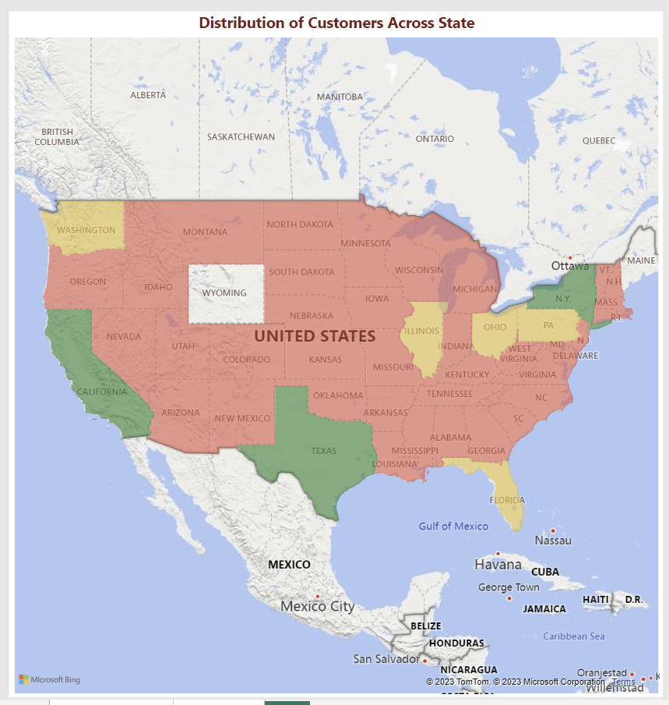
7. DATA VISUALIZATION
The distribution of customers across different demographics

Slide 29
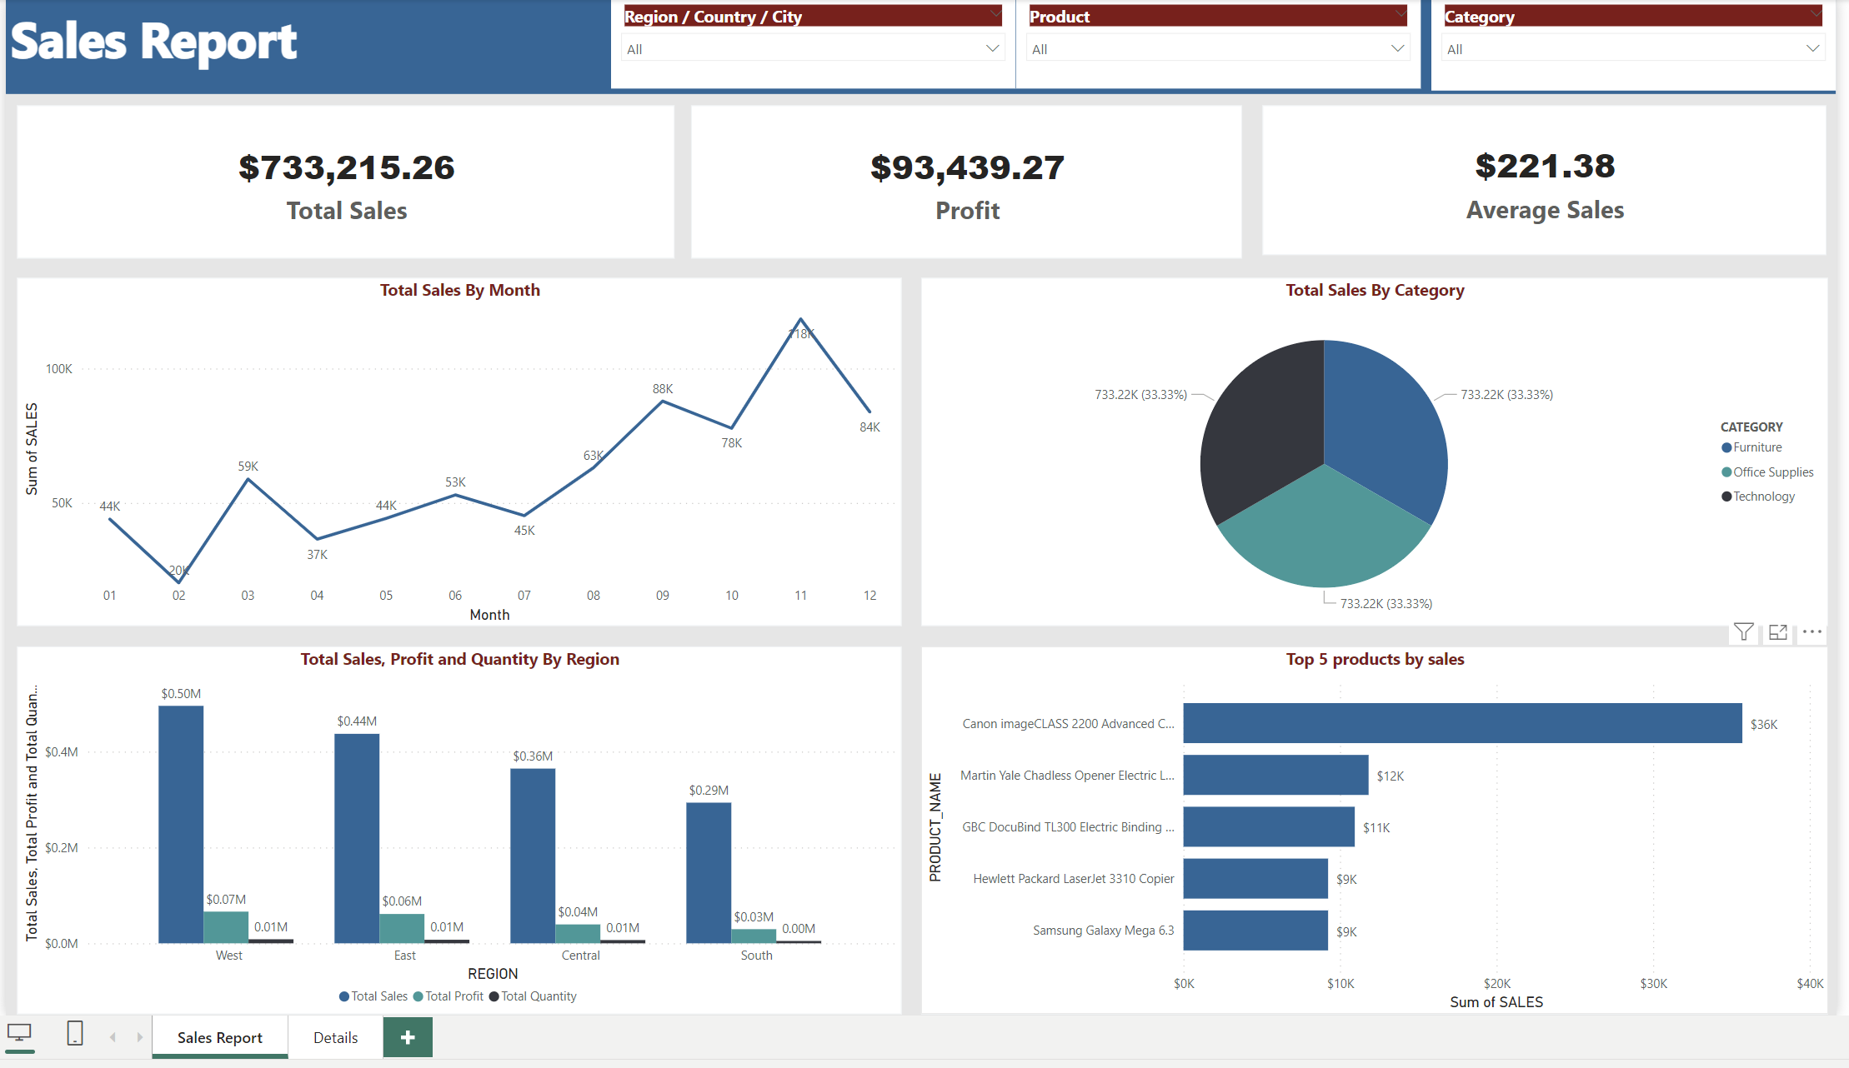
POWER BI DASHBOARD COMPLETE VIEW

Slide 30
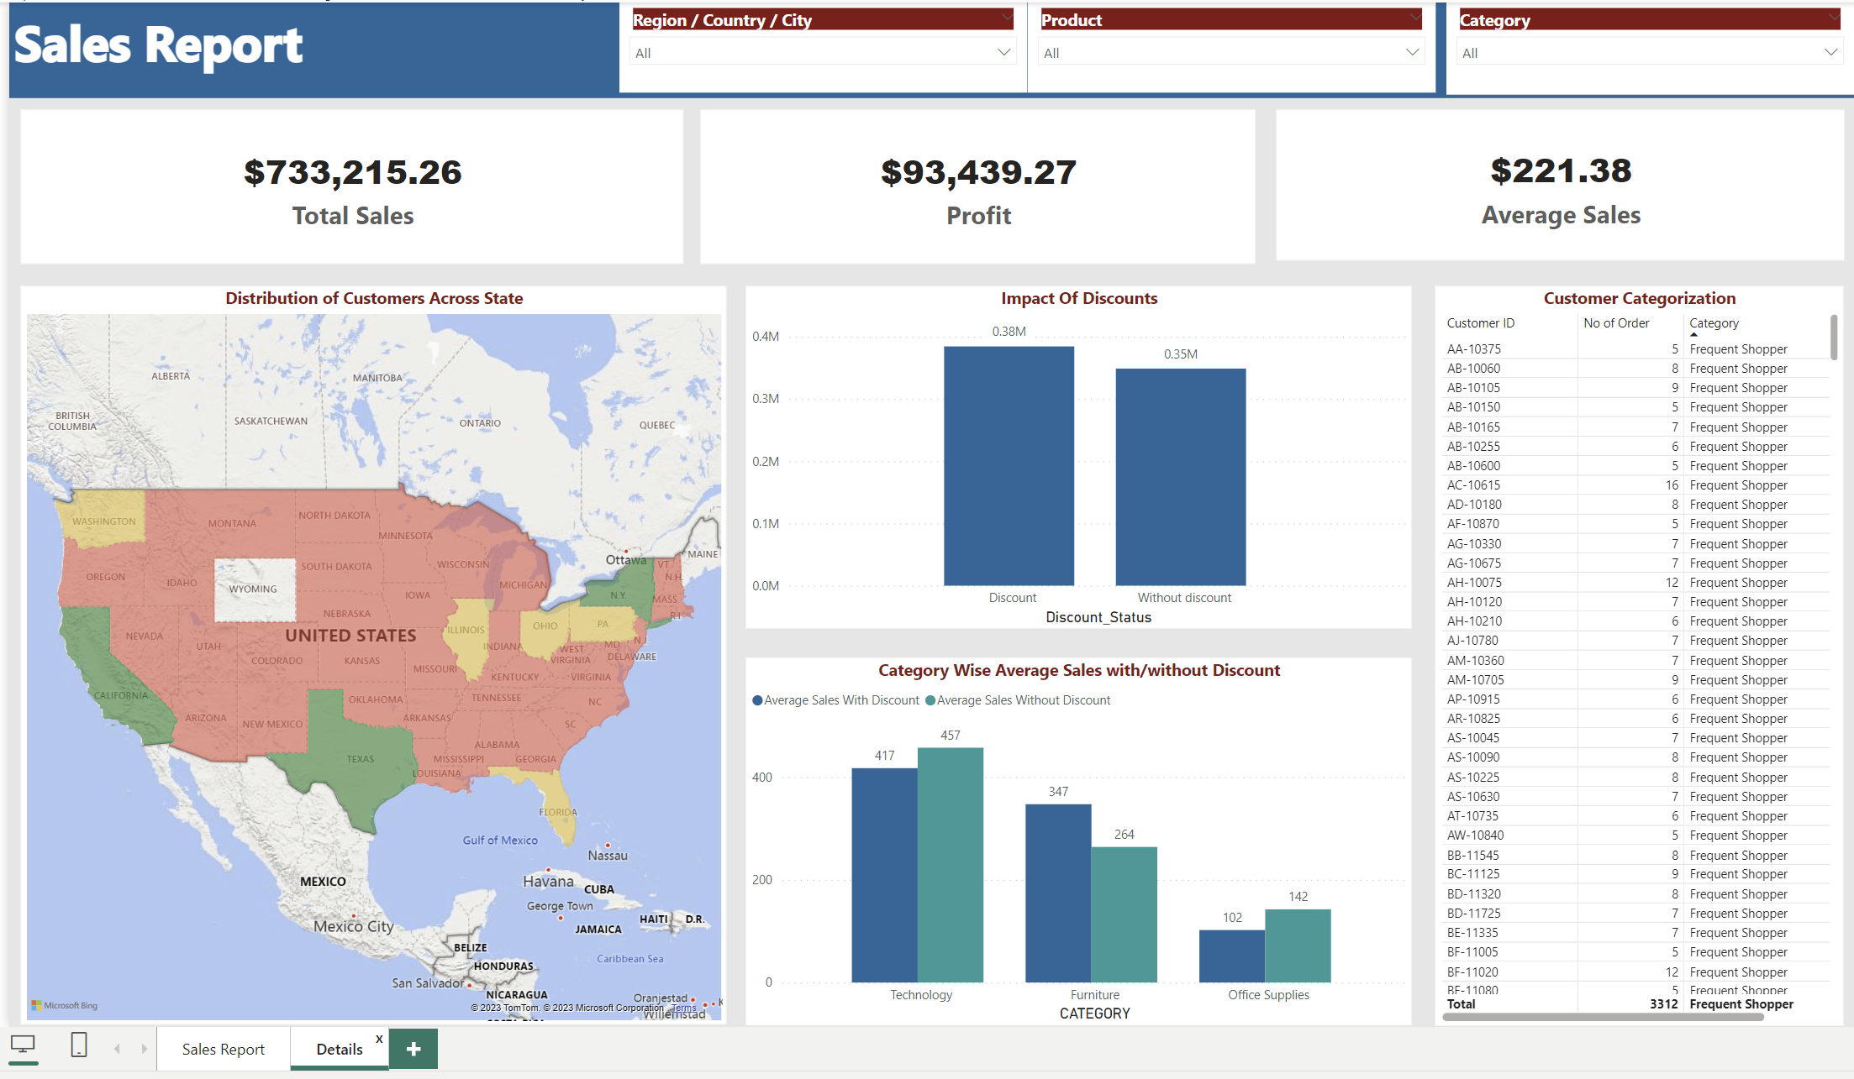
POWER BI DASHBOARD COMPLETE VIEW

Slide 31
RESULTS SUMMARY
Efficient Data Architecture: Implemented a simple and efficient data architecture leveraging Snowflake capabilities. Layering data into raw, staging and main data layers. This architecture ensures data integrity, quality, and accessibility for reporting.
ELT Process: Integrated an Extract, Load, Transform (ELT) process, where after being loaded into staging schema data from the source file undergoes various validations and processing. This process guarantees high-quality data for reporting in Power BI.
Normalized Data Model: Utilized normalization techniques to structure the Orders fact table and related dimension tables, minimizing redundancy, and improving data integrity while optimizing query performance.
Enhanced Data Quality: Implemented data cleaning steps such as handling missing values, removing duplicates, standardizing formats, and addressing inconsistencies, ensuring data quality and reliability across schemas.
Reporting Data: Established a reliable reporting layer in the main schema, providing a clean and refined dataset for Power BI integration. This structured data facilitates accurate and insightful reporting and analysis.
Data Visualisation for better Insights: Provided a dashboard rendering the data from main table using Power-BI enabling stakeholders to derive actionable insights.
Overall, the project has succeeded in establishing a well-structured, efficient, and reliable data pipeline from raw data ingestion to refined reporting, enhancing the value and usability of the data for business intelligence and decision-making purposes.

Slide 32

References
Snowflake Documentation
https://docs.snowflake.com/en/guides-overview
"E-commerce" by Statista
https://www.statista.com/markets/413/e-commerce/
Linoff, Gordon S - Data Analysis Using SQL and Excel-Wiley
https://www.temida.si/~bojan/MPS/materials/Data%20Analysis%20Using%20SQL%20and%20Excel.pdf

Slide 33
FUTURE WORK
Predictive Analysis:
The data we have shows the types of products which will be in demand at any time of the year.
We can use this data to predict future demand of products and keep them in stock and suggest variations to customers.
Price competitiveness:
Scrape data from competitor sites and map them to the data in our warehouse. This can be used in studying price competitiveness of our products. This can also be extended as a price matching solution in future.
Customer Lifetime Value(CLV) prediction:
Calculate Customer Lifetime Value (CLV) for different customer segments. This can be done using historical data and predictive analysis on future purchases. This is an important metric to predict business growth and trends.

Slide 34

Q&A

Slide 35

Thank you

